Slide 1
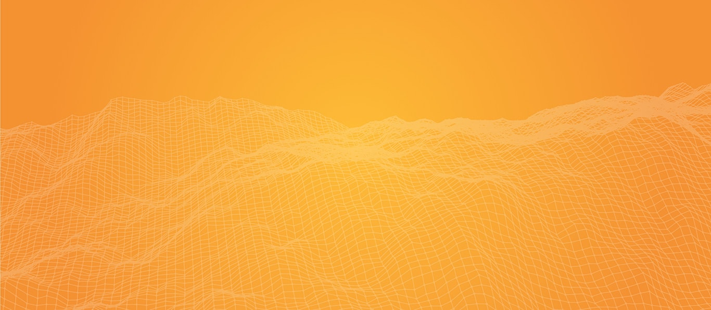
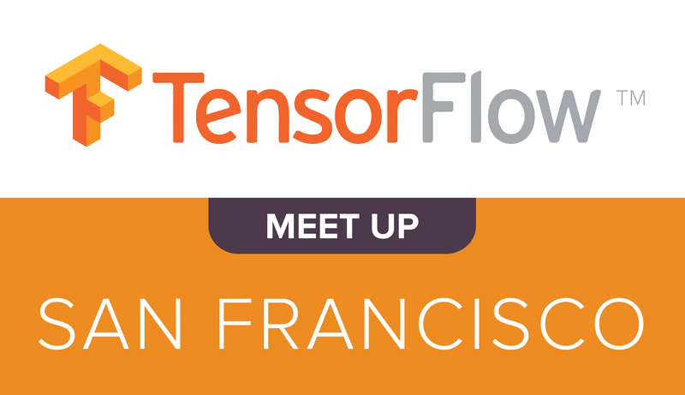


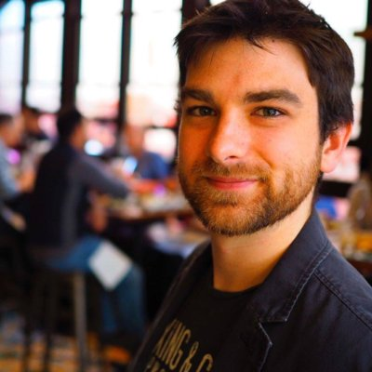
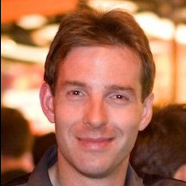
May 17, 2016
San Francisco, CA
Meetup sponsors:
TensorFlow Use Cases
Alex Londeree
Sr Data Scientist
@ Knit Health
Yaroslav Bulatov
Software Engineer
@ Google

